Slide 1
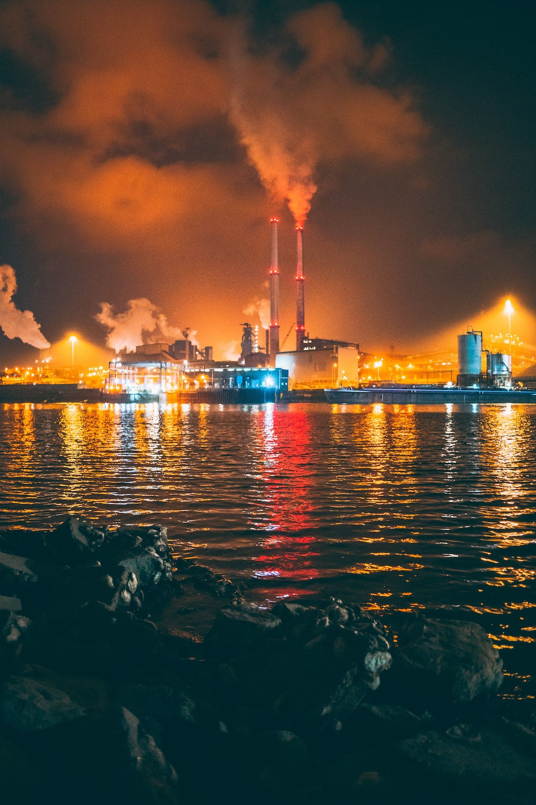
THERMAL POLLUTION

Slide 2
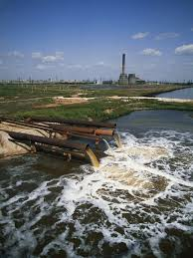
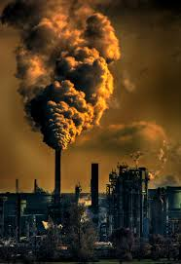
WHAT IS THERMAL POLLUTION?
Thermal pollution is the degradation of water quality by any process that changes the water temperature. In other words, it is the defined as increase or decrease in temperature of a natural body of water like ocean, lake or river by human influence.

Slide 3
SOURCES OF THERMAL POLLUTION
The major sources of thermal pollution are as follows –
Industrial effluents
Domestic Sewage
Deforestation
Soil Erosion

Slide 4
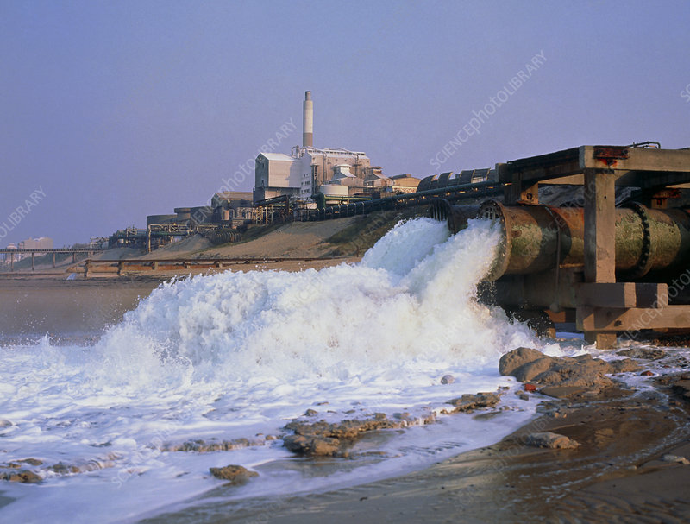
INDUSTRIAL EFFLUENTS
A common use of thermal pollution is use of water as a coolant by power plants and industrial manufacturers.
When water used as a coolant is returned to the natural environment at a higher temperature, the sudden change in temperature decreases oxygen supply and effects ecosystem.

Slide 5
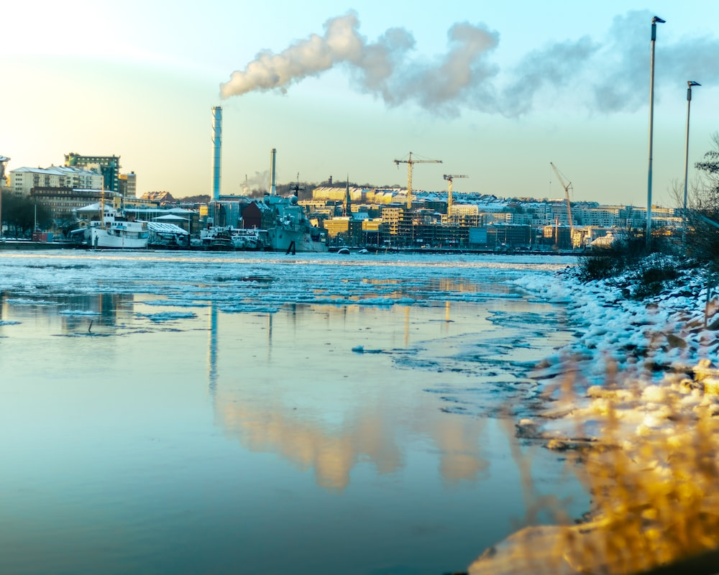
DOMESTIC SEWAGE
Sewage is commonly discharged into lakes, canals or streams.
Municipal sewage has higher temperature than the receiving water.
Increase in temperature of receiving water decreases dissolved oxygen of water.
This effects aquatic life in marine.

Slide 6
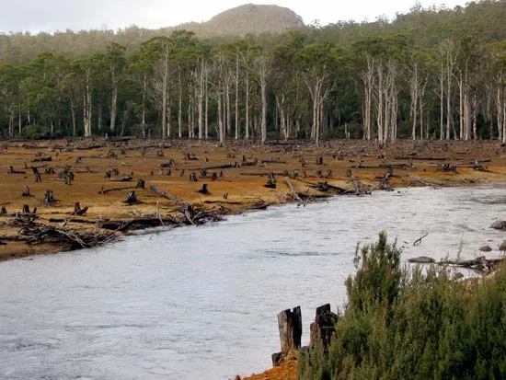
DEFORESTATION
Deforestation is the removal of forest or cutting of trees from land which is converted into non forest use.
Trees and plant prevents sunlight from falling directly on lakes, ponds or rivers.
When deforestation takes place, these water bodies gets directly exposed to sunlight, thus absorbing more heat and increasing its temperature.

Slide 7
SOIL EROSION

